Slide 1
Git Tutorial

Slide 2
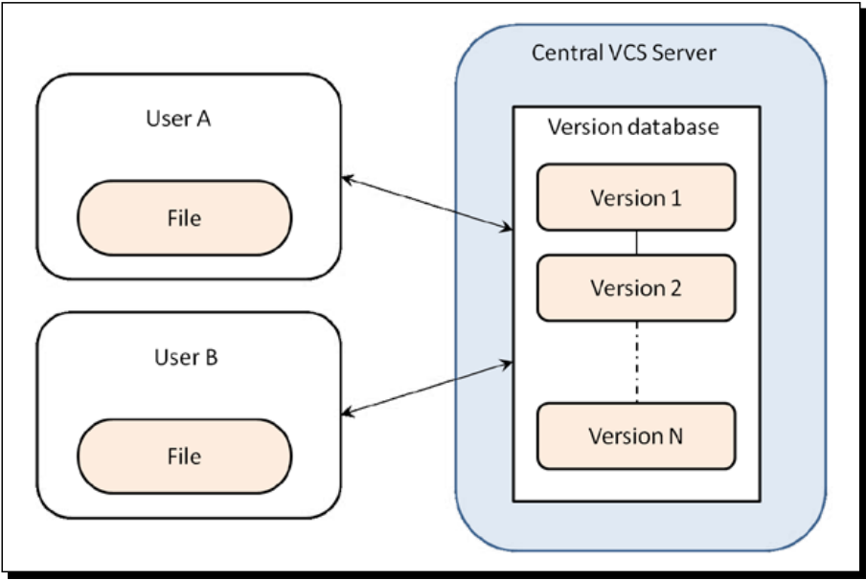
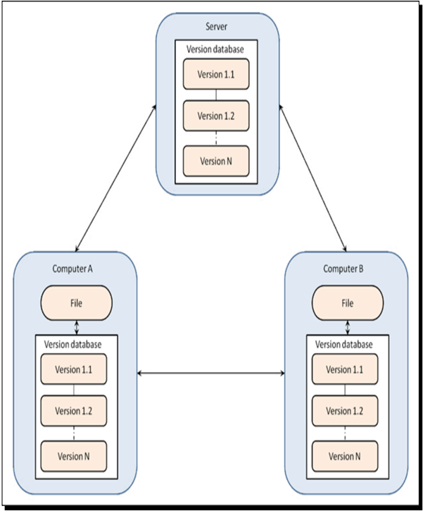
Centralized vs. Distributed VCS
Centralized – Perforce
In CVCS, All users access a single central repository, and user copy (checkout) a certain version from that repository.
All user communicates through this central repository. If the file is locked, others cannot check in the file.
You need to have connection to access the server
Distributed – Git
In a DVCS each user has a complete local copy of a repository on his individual computer. The user can do anything to this local repository as they do in centralized system.
Every repository can exchange versions of the files with other repositories by transporting these changes (ssh,git protocol, or http)

Slide 3
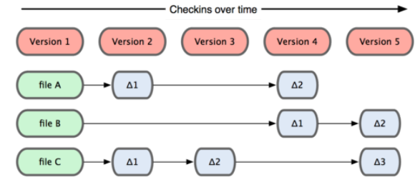
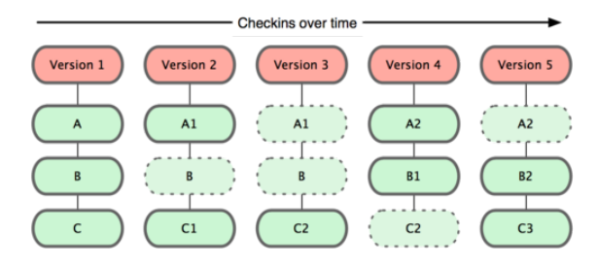
Snapshots, Not Differences
Traditional VCS stores data as changes to a base version of each file.
To checkout the latest version you need to go through all the differences of the file.
Git stores data as snapshots of the project over time.
It is very fast to checkout the latest version.

Slide 4
Git Object
How Git stores file and directory
Everything in Git is check-summed before it is stored and is then referred to by that checksum. This means it’s impossible to change the contents of any file or directory without Git knowing about it.
The mechanism that Git uses for this checksumming is called a SHA-1 hash(Secure Hash Algorithm 1). This is a 40-character string composed of hexadecimal characters (0–9 and a–f) and calculated based on the contents of a file or directory structure in Git. A SHA-1 hash looks something like this:
24b9da6552252987aa493b52f8696cd6d3b00373
Git object type: Blob, Tree, Commit, Tag

Slide 5
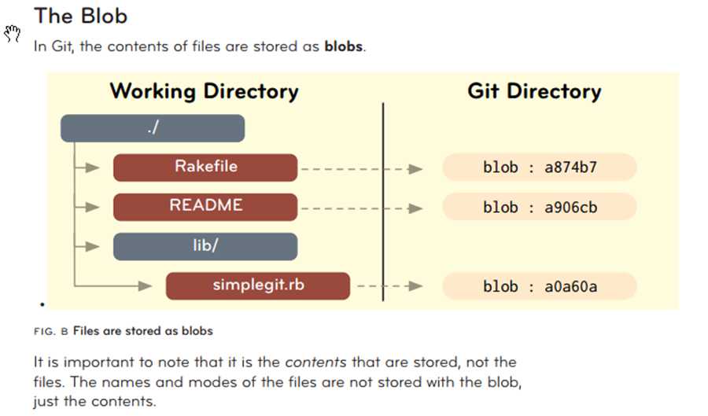
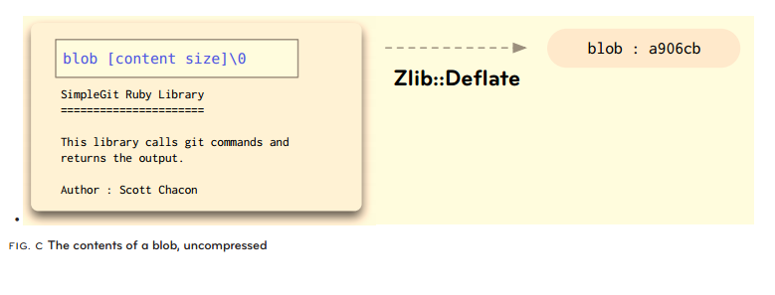
The Blob

Slide 6
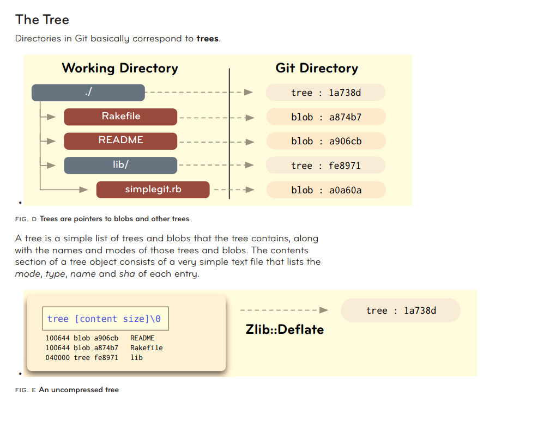
The Tree

Slide 7
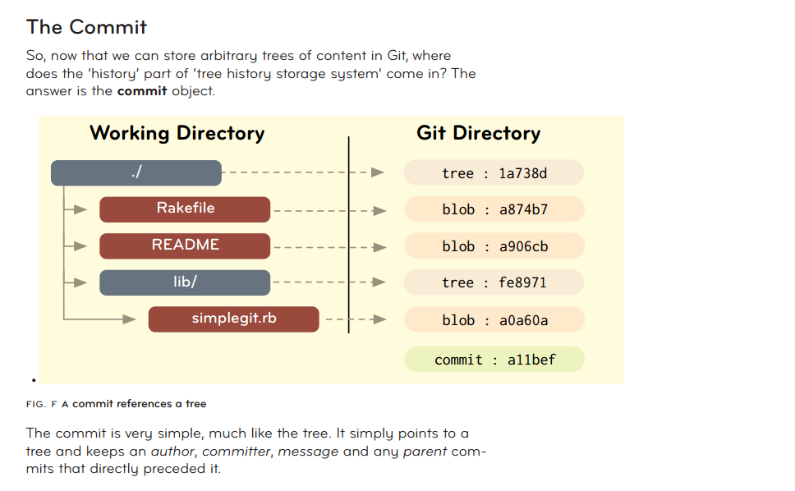
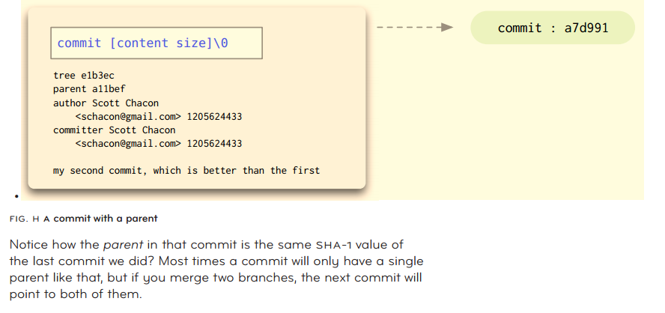
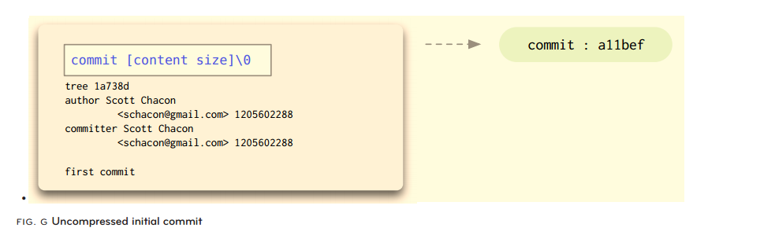
The Commit

Slide 8
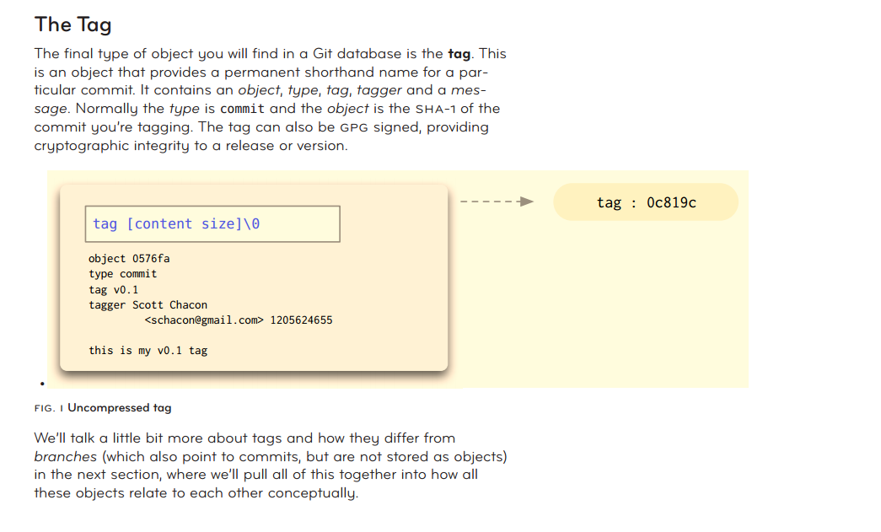
The Tag

Slide 9
Getting a Git Repository
Start a New Project
git init ( this creates a new local repository )
git add
git commit
Push to github
Git remote add origin url
Git push –u origin master
Work on an Existing Project
Git clone
Git clone https://github.com/echangtts/hello-world.git (to default directory)
Git clone https://github.com/echangtts/hello-world.git mydir
Config Setup
Git config
git config --global user.name <name> (global means for all repos)
git config [--local] user.email <email> (local means for current local repo, this is default)

Slide 10
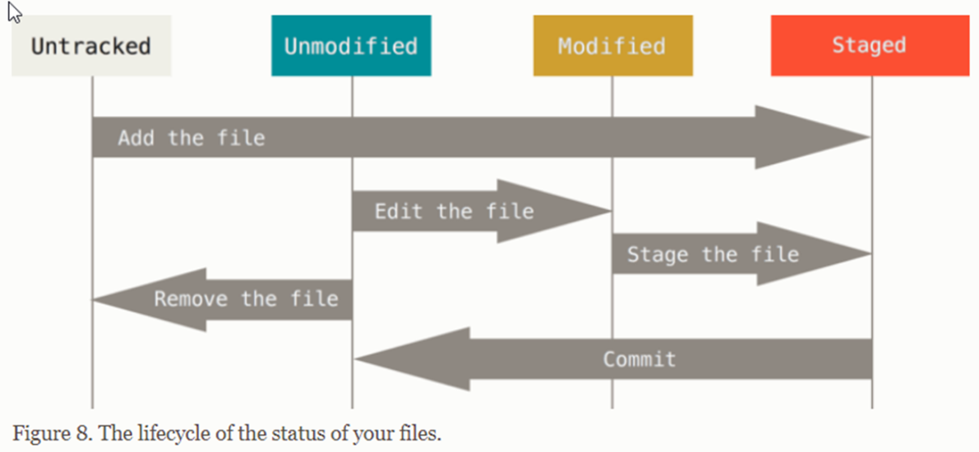
File Status in working directory
Tracked or Untracked
Each file in your working directory can be in one of two states: tracked or untracked.
Tracked files are files that were in the last snapshot; they can be unmodified, modified. Untracked files are everything else.
Tracked/Unmodified
When you first clone a repository, all of your files will be tracked and unmodified because you just checked them out and haven’t edited anything.
Tracked/Modified
Unstaged: File content is not indexed yet
Staged: File content has been indexed

Slide 11
Working on the Repository
Checking the status of your files
>git status
>git add - i
Example
Viewing Your Staged and Unstaged Changes
>git diff (view unstaged difference)
>git diff -cached (view staged difference)
Example
Ignoring Files
.gitignore
Committing Your Changes
Remember that anything that is still unstaged — any files you have created or modified that you haven’t run git add on since you edited them - won’t go into this commit.
>git commit (edit your message)
>git commit -v (show your modification)
>git commit -m ‘your message’ (add you message directly)
>git commit -a -m ‘your messgae’ (staged and commit together)

Slide 12
Working on the Repository
Removing Files
To remove a file from Git, you have to remove it from your tracked files (more accurately, remove it from your staging area) and then commit.
>git rm <file> (remove file from working directory)
>git rm --cached <file> (remove from staging area, but keep it in working dir)
If you simply remove the file from your working directory, it shows up under the “Changed but not updated” (that is, unstaged) area of your git status output.
Moving Files(rename)
Git mv file_from file_to
Viewing the Commit History
>git log
>git log -p [-n](where n the last n entries.)
>git log -p file

Slide 13
Sharing the Repository
Working with Remotes
Showing Your Remotes
git remote -v
Adding Remote Repositories
git remote add [shortname] [url]
Fetching and Pulling from Your Remotes
git fetch
git pull
Pushing to Your Remotes
git push origin master

Slide 14
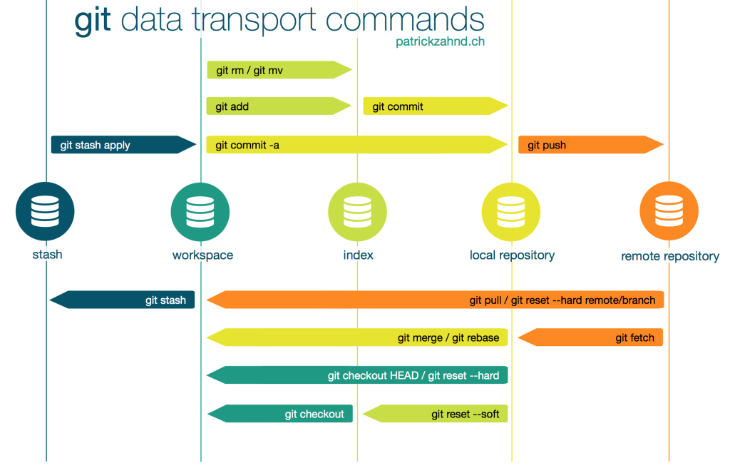

Slide 15
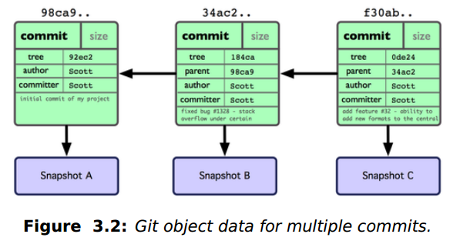
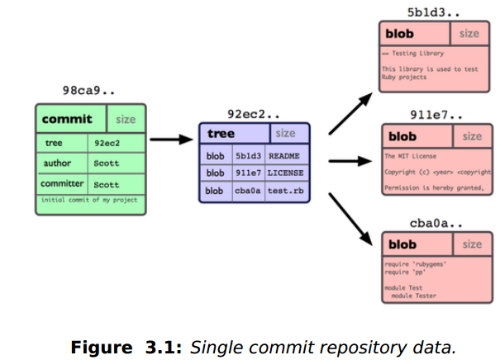
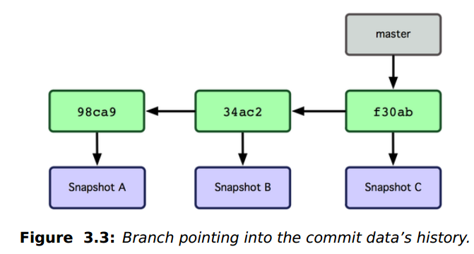
What a branch is
A branch in Git is simply a lightweight movable pointer to one of these commits. The default branch name in Git is master. As you initially make commits, you’re given a master branch that points to the last commit you made. Every time you commit, it moves forward automatically.

Slide 16
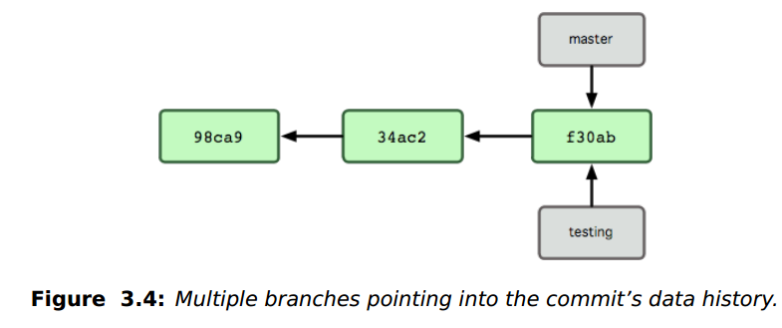
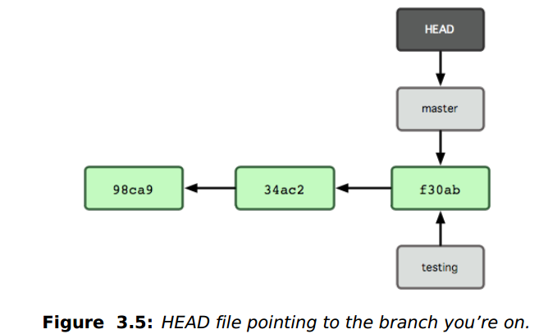
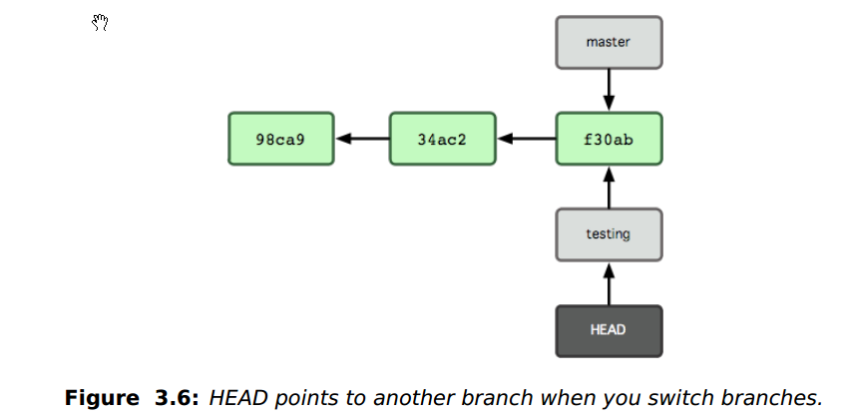
What a branch is
$ git branch testing
This creates a new pointer at the same commit you’re currently on (see Figure 3.4).
How does Git know what branch you’re currently on? It keeps a special pointer called HEAD
The git branch command only created a new branch — it didn’t switch to that branch (see Figure 3.5).
$ git checkout testing
This moves HEAD to point to the testing branch (see Figure 3.6).

Slide 17
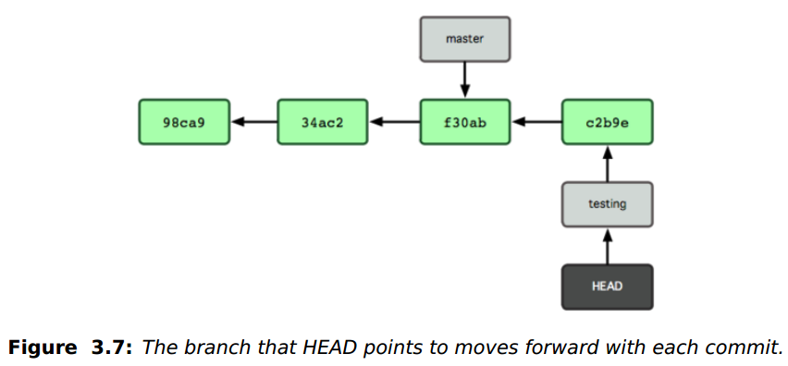
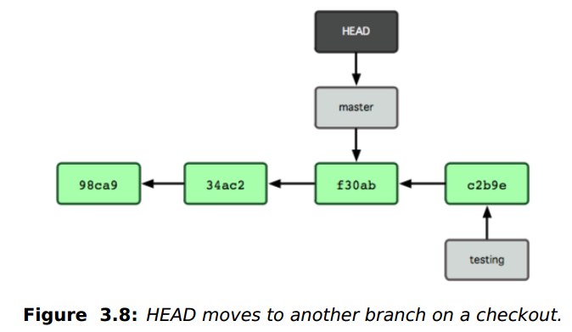
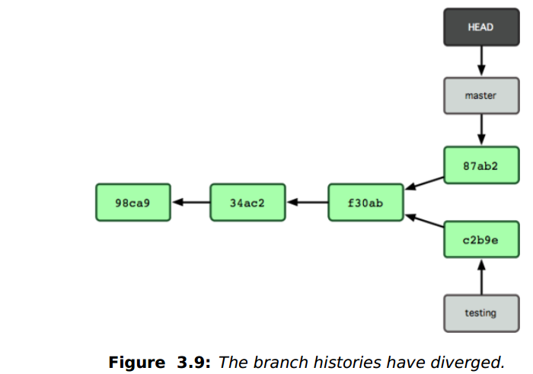
What a branch is
$vi file.py $ git commit -a -m 'made a change' (See Fig 3.7)
$ git checkout master (see Fig 3.8)
$ vi file.py $ git commit -a -m 'made other changes' (see Fig 3.9)

Slide 18
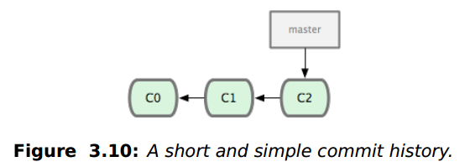
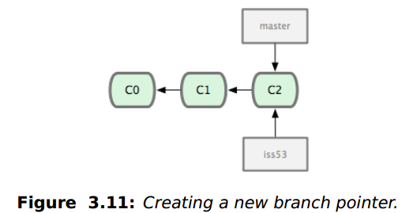
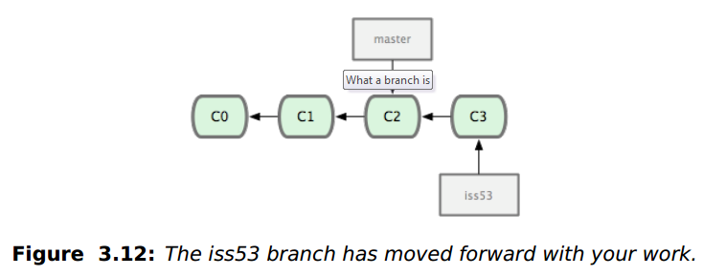
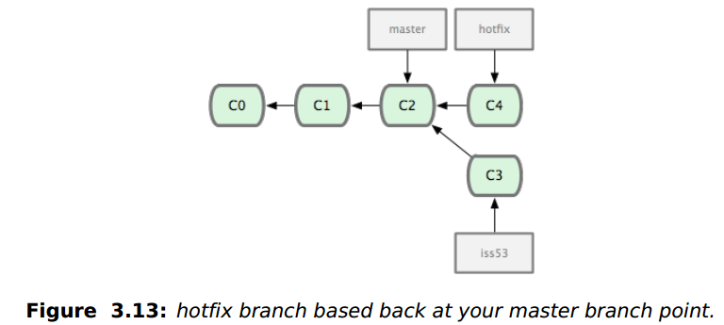
Basic Branching and Merge
First, let’s say you’re working on your project and have a couple of commits already (see Figure 3.10).
$ git branch iss53 $ git checkout iss53 (Fig 3.11)
$ vim index.html $ git commit -a -m 'added a new footer [issue 53]' (Fig 3.12)
$ git checkout master Switched to branch "master"
$ git checkout -b 'hotfix' Switched to a new branch "hotfix" $ vim index.html $ git commit -a -m 'fixed the broken email address' (Fig 3.13)

Slide 19
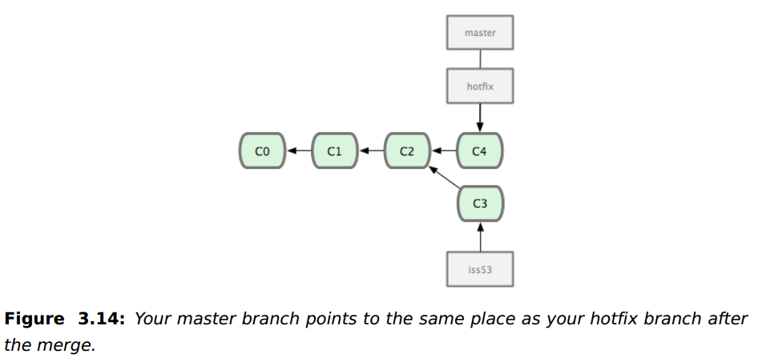
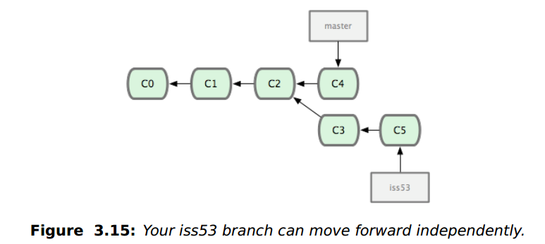
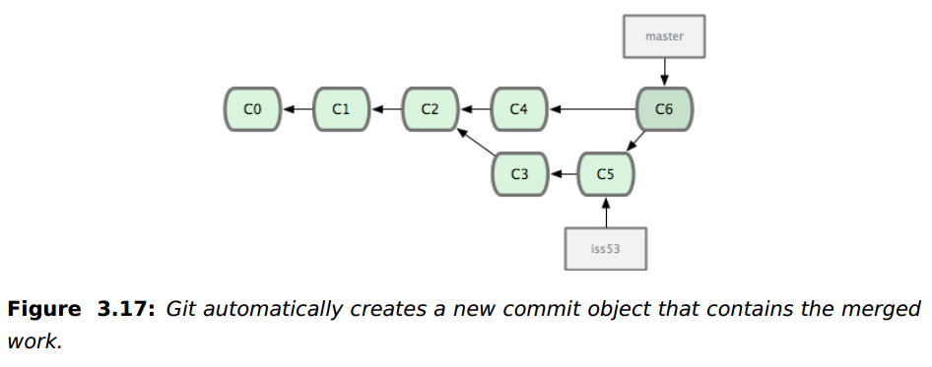
Basic Branching and Merge
$ git checkout master $ git merge hotfix
Fig 3.14
(Fast-forward: Because the commit C4 pointed to by the branch hotfix you merged in was directly ahead of the commit C2 you’re on, Git simply moves the pointer forward.)
$ git branch -d hotfix Deleted branch hotfix (3a0874c).
Back on issue53 $ git checkout iss53
$ git commit -a -m 'finished the new footer Fig 3.15
$ git checkout master $ git merge iss53 Fig 3.16

Slide 20
Some Guideline for Version Control
COMMIT RELATED CHANGES
A commit should be a wrapper for related changes. For example, fixing two different bugs should produce two separate commits. Small commits make it easier for other developers to understand the changes and roll them back if something went wrong. With tools like the staging area and the ability to stage only parts of a file, Git makes it easy to create very granular commits.
COMMIT OFTEN
Committing often keeps your commits small and, again, helps you commit only related changes. Moreover, it allows you to share your code more frequently with others. That way it‘s easier for everyone to integrate changes regularly and avoid having merge conflicts. Having few large commits and sharing them rarely, in contrast, makes it hard to solve conflicts
USE BRANCHES
Branching is one of Git‘s most powerful features - and this is not by accident: quick and easy branching was a central requirement from day one. Branches are the perfect tool to help you avoid mixing up different lines of development. You should use branches extensively in your development workflows: for new features, bug fixes, ideas…

Slide 21

A successful Git branching model

